Slide 1
Richard Meagher
Efficacy of a multisensory stimulus model in the treatment of pathological worry in children: Evaluation of a modified Acceptance Based Behavior Therapy (ABBT)

Slide 2
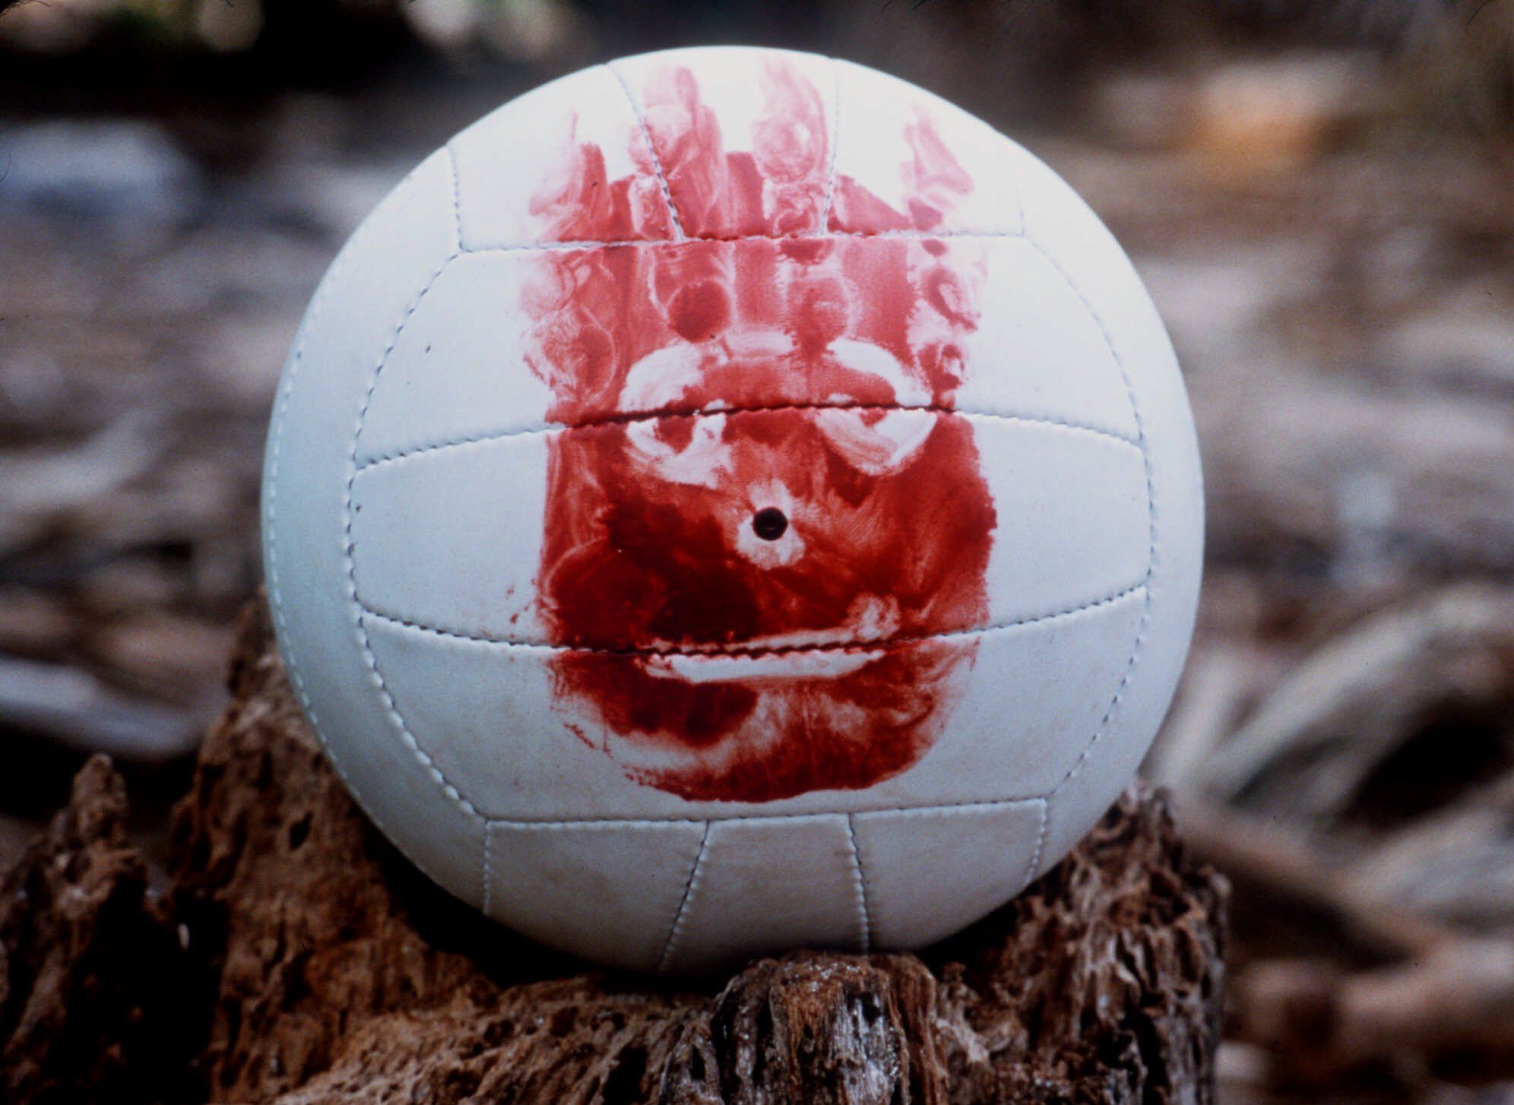

Slide 4
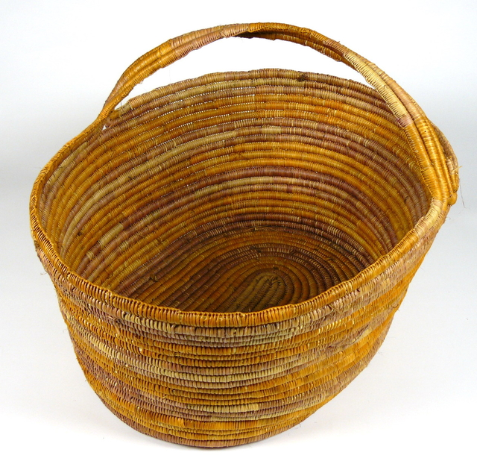
‘Too hard’ basket

Slide 5
Observable avoidance behaviours

Slide 6
Observable avoidance behaviours
Relaxation
Graduated exposure
Mindfulness/acceptance exercises

Slide 7
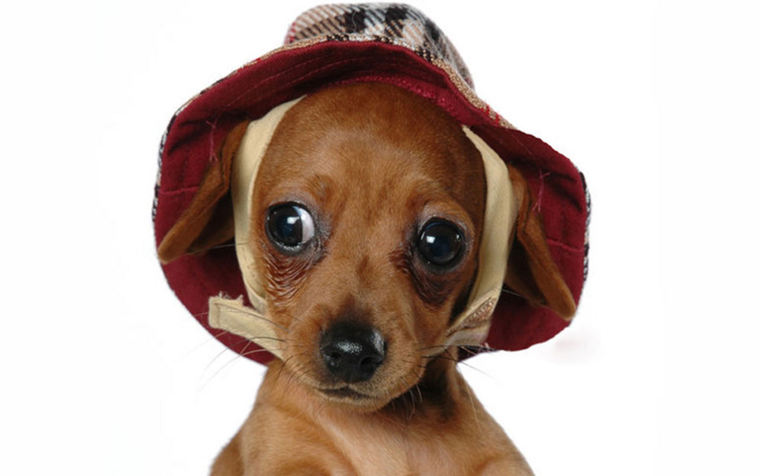

Slide 8
Language-based processing behaviour eg. Worry

Slide 9
Language-based processing behaviour
eg. Worry
Requires metacognition

Slide 10

I can choose which thoughts to engage in?

Slide 11
Create learning experiences that are….
visual
concrete
interactive

Slide 12
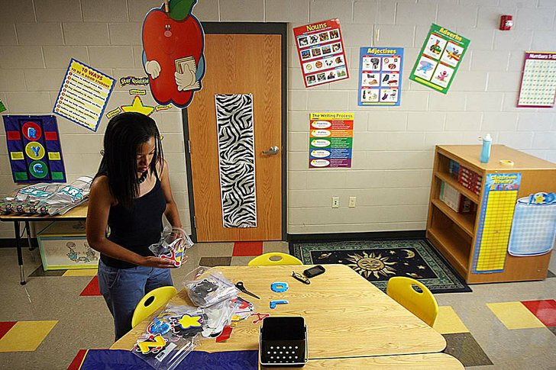

Slide 13
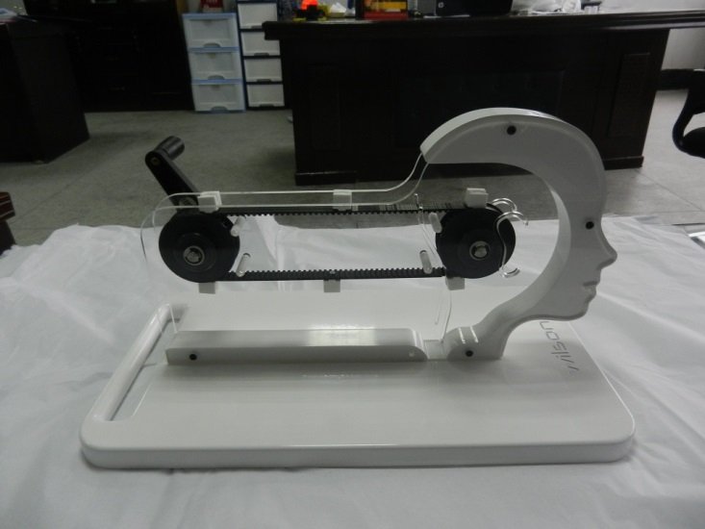

Slide 14
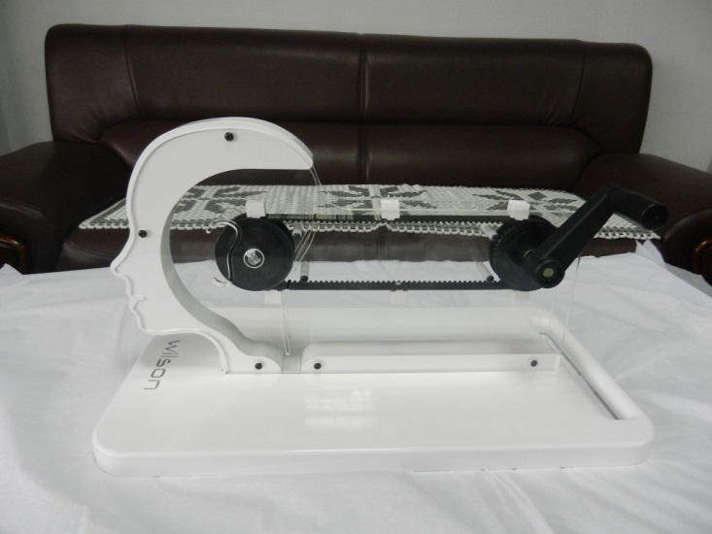

Slide 17
Evidence?

Slide 18
Evidence?
Educational literature

Slide 19
Evidence?
Educational literature
Lab studies

Slide 20
Thank you

